Slide 1

STAT 632: Regression Analysis
Predicting Road Accident Severity in the US (2016-2023) : A Multiple Linear Regression and Random Forest Analysis
Presented by: Instructor :
Shrusthi H C
Dr. Joshua Kerr
Shruti Gajre
Namitha Kuthani
Last updated: May 6th, 2025

Slide 2

Agenda
Introduction & Motivation
Project Goal & Research Questions
Dataset Overview
Data Preprocessing & EDA
Modeling Approaches
Multiple Linear Regression (Full vs. Reduced Model)
Logistic Regression
Random Forest Classification
Model Evaluation
Key Results & Interpretation
Conclusion & Future Work

Slide 3

Project Goal & Research Question:
Project Goal
To analyze patterns in road accidents across the United States from 2016 to 2023 using regression models. The aim is to predict accident severity and identify the most influential factors contributing to severe outcomes.
Research Questions
What are the key predictors of road accident severity in the US?
How do environmental and temporal factors (e.g., weather, visibility, time of day) influence the severity of road accidents?
Can Multi-linear regression and Random forest models accurately classify and predict accident severity?

Slide 4

Dataset Overview
Source: Kaggle – U.S. Accidents (2016-2023)
Data size: 7.7 Million entries, 46 total columns
Sample Size: 50,000 rows
Target Variable: Severity (1 to 4)
Key Predictors: Weather: temperature, rain, fog, State etc.
Road Features: Bump, junction, traffic signal etc..
Time: Peak hour, weekend

Slide 5








Common Causes of Car Accidents
Distracted Driving
Phones and infotainment systems divert attention
Impaired Driving
Alcohol, drugs, and fatigue impair judgment
Speeding
Causes 29% of US traffic deaths
Weather Conditions
Rain, snow, and fog reduce visibility and control

Slide 6
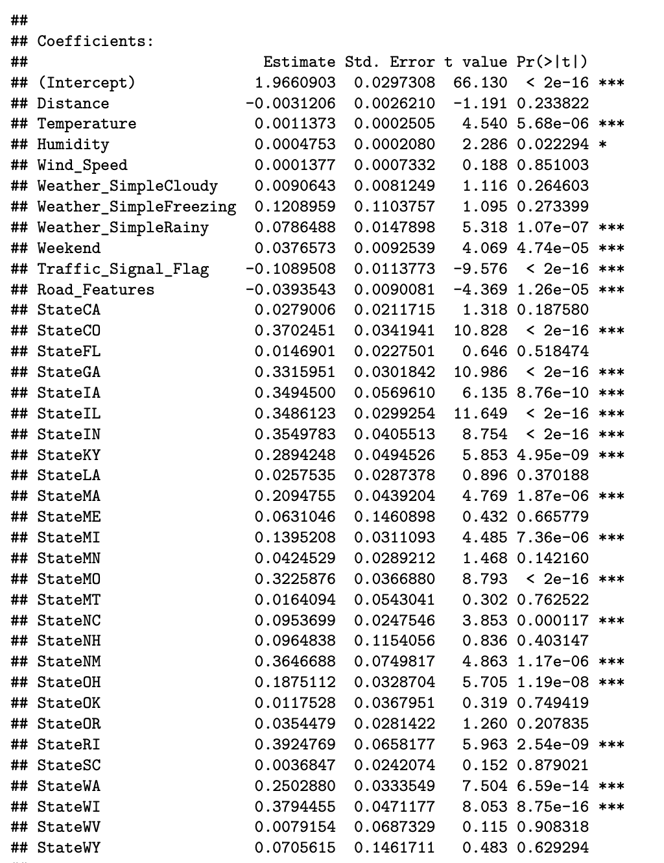
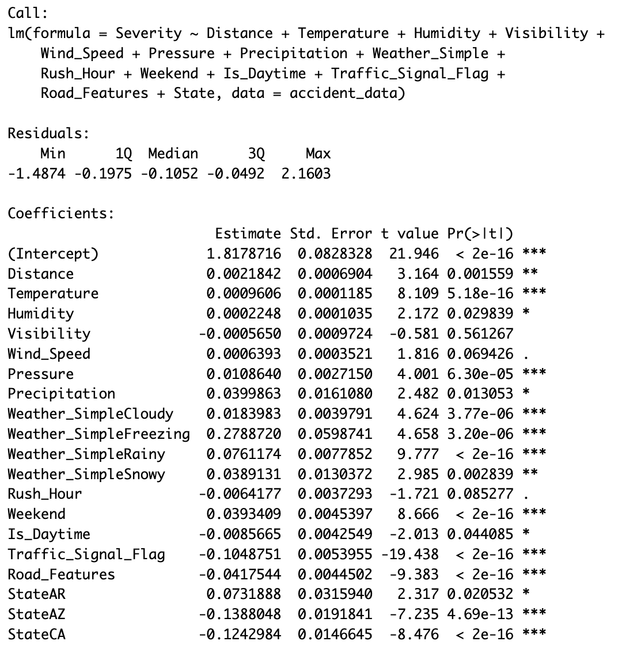
Multiple Linear Regression
Reduced model Results
MLR Full Model Results:
Adjusted R² = 0.060 → Model explains ~6% of variance in severity
F-statistic = 21.08, p < 0.05 → Model is statistically significant
Residual standard error = 0.4379 (indicates moderate prediction error)
The reduced model has better explanatory power (Adjusted R² = 7.8% vs. 6.0%)
It also has lower residual error, indicating tighter model fit
Unnecessary or insignificant predictors were removed — improving model simplicity and interpretability
Focuses only on important weather types and states
Avoids multicollinearity, as shown by improved VIF scores

Slide 7
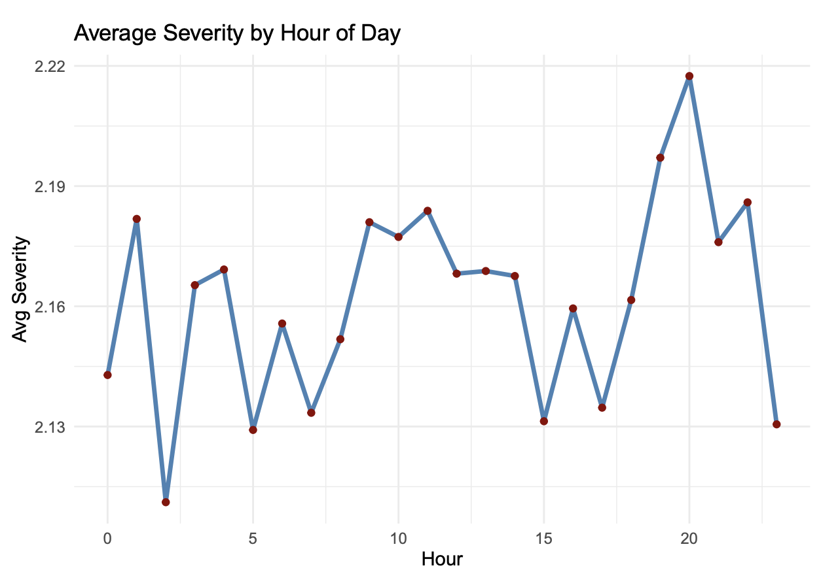
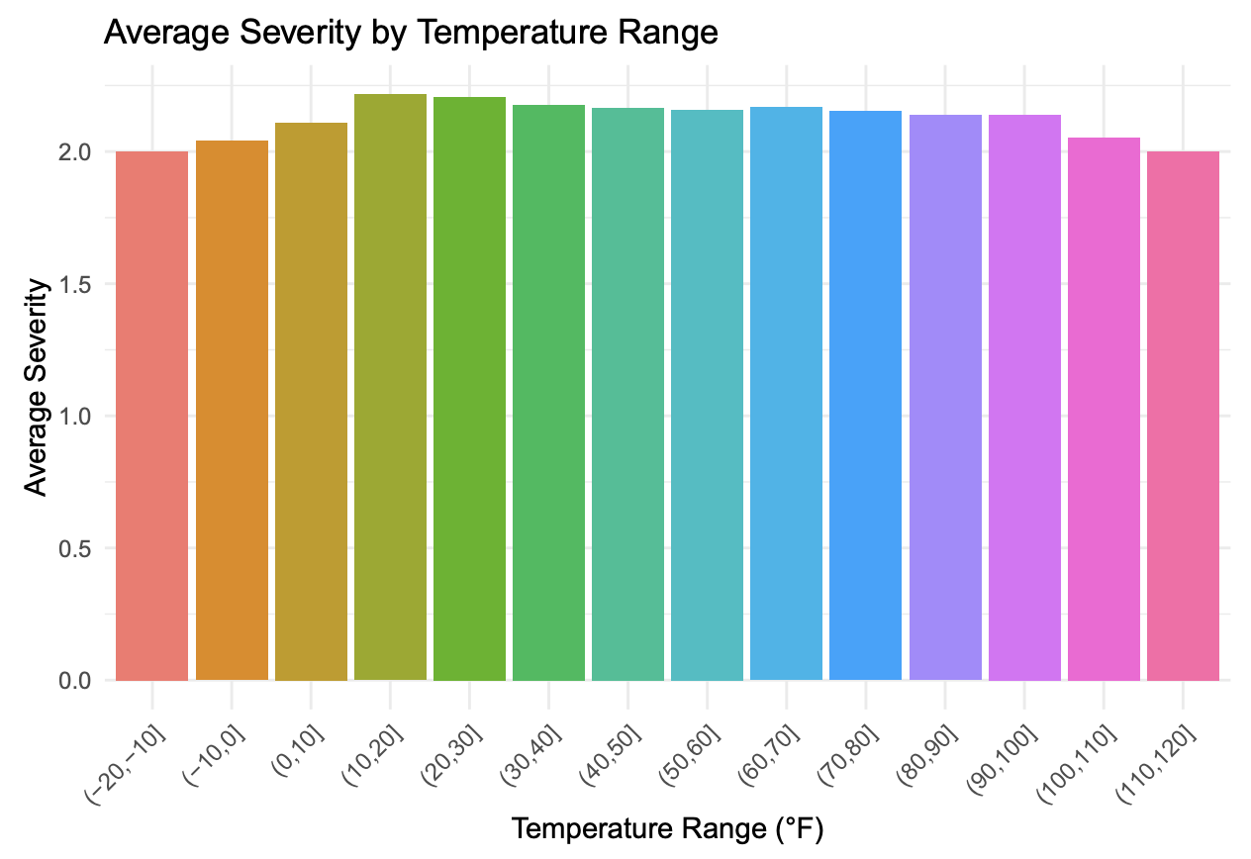
Trend of average severity by hour:
Average Severity by Temperature Range:
Shows average accident severity for each hour (0 to 23)
Severity fluctuates throughout the day, mostly ranging between 2.13 and 2.22
Highest average severity occurs between 7 PM and 9 PM
Lowest severity appears around early morning (2–4 AM) and mid-afternoon (3–5 PM)
No clear peak during traditional rush hours (7–9 AM and 4–6 PM)
Severity peaks in the 20°F to 30°F range
Temperatures below freezing and above 100°F are associated with lower average severity
Overall, mid-range temperatures (20–60°F) show the highest average severity
Severity gradually declines after ~60°F

Slide 8
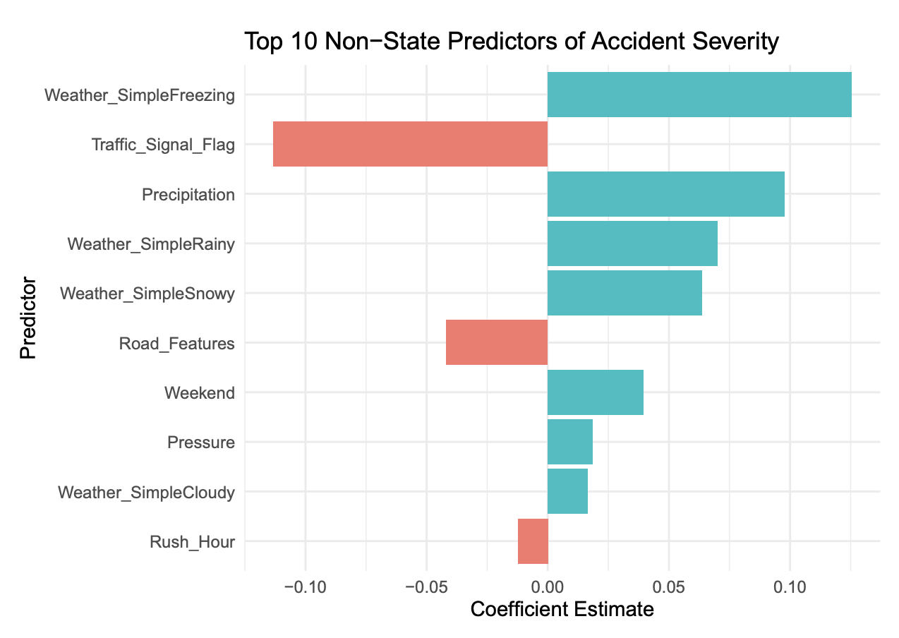
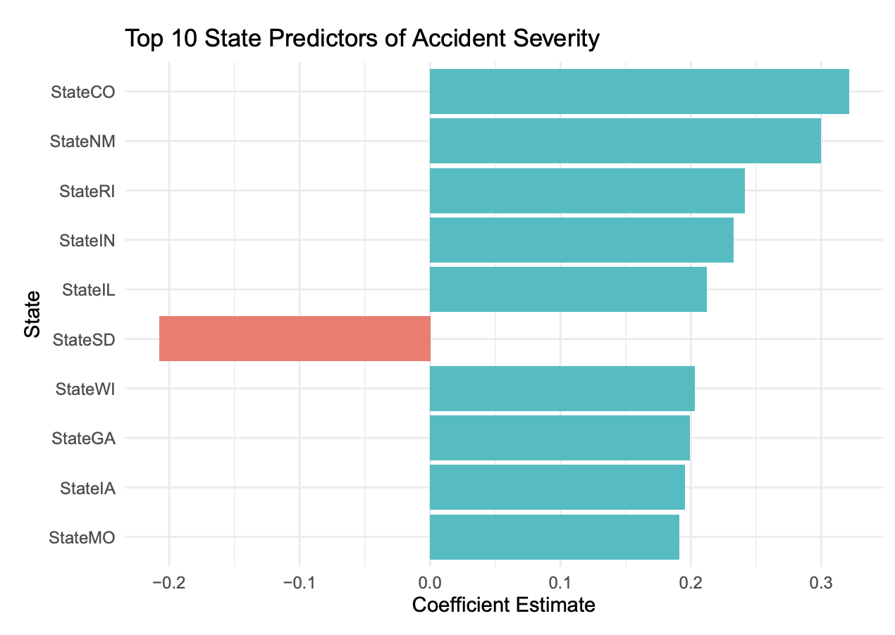
Bar plot of model coefficients:
Weather Freezing and Precipitation have the strongest positive effects on severity
Traffic Signal Flag and Road Features show negative effects, meaning their presence reduces severity
Rainy and Snowy weather both increase severity, with Rainy having a stronger impact
Weekend accidents are slightly more severe on average
Pressure and Cloudy conditions also contribute, but to a lesser extent
Rush Hour appears to slightly reduce severity (possibly due to congestion reducing speed)
Colorado (CO) shows the highest positive effect on accident severity
New Mexico (NM), Rhode Island (RI), Indiana (IN), and Illinois (IL) also show significantly higher severity
South Dakota (SD) is the only state in this list with a negative effect, indicating lower average severity
Differences reflect regional driving behavior, infrastructure, enforcement, or reporting standards
State effects capture variability not explained by weather or road features alone
Notes:
This bar plot displays the top non-state predictors in our multiple linear regression model. The most influential positive predictors are Freezing weather and Precipitation, both of which are intuitively linked to hazardous driving conditions. On the other hand, traffic signals and road features like crossings and junctions reduce severity, likely because they encourage slower and more cautious driving. We also see that weekend accidents tend to be slightly more severe — possibly due to higher
This plot shows the top 10 state-level predictors from our regression model. States like Colorado, New Mexico, and Illinois are associated with significantly higher accident severity, even after controlling for weather and road conditions. This could be due to differences in geography, enforcement, or traffic patterns in those states. Interestingly, South Dakota shows a negative effect, indicating lower severity relative to the reference state. Including state as a predictor helped improve ou
send
Send message
11:00PM
This plot shows the top 10 state-level predictors from our regression model. States like Colorado, New Mexico, and Illinois are associated with significantly higher accident severity, even after controlling for weather and road conditions. This could be due to differences in geography, enforcement, or traffic patterns in those states. Interestingly, South Dakota shows a negative effect, indicating lower severity relative to the reference state. Including state as a predictor helped improve ou
This plot shows the top 10 state-level predictors from our regression model. States like Colorado, New Mexico, and Illinois are associated with significantly higher accident severity, even after controlling for weather and road conditions. This could be due to differences in geography, enforcement, or traffic patterns in those states. Interestingly, South Dakota shows a negative effect, indicating lower severity relative to the reference state. Including state as a predictor helped improve ou

Slide 9

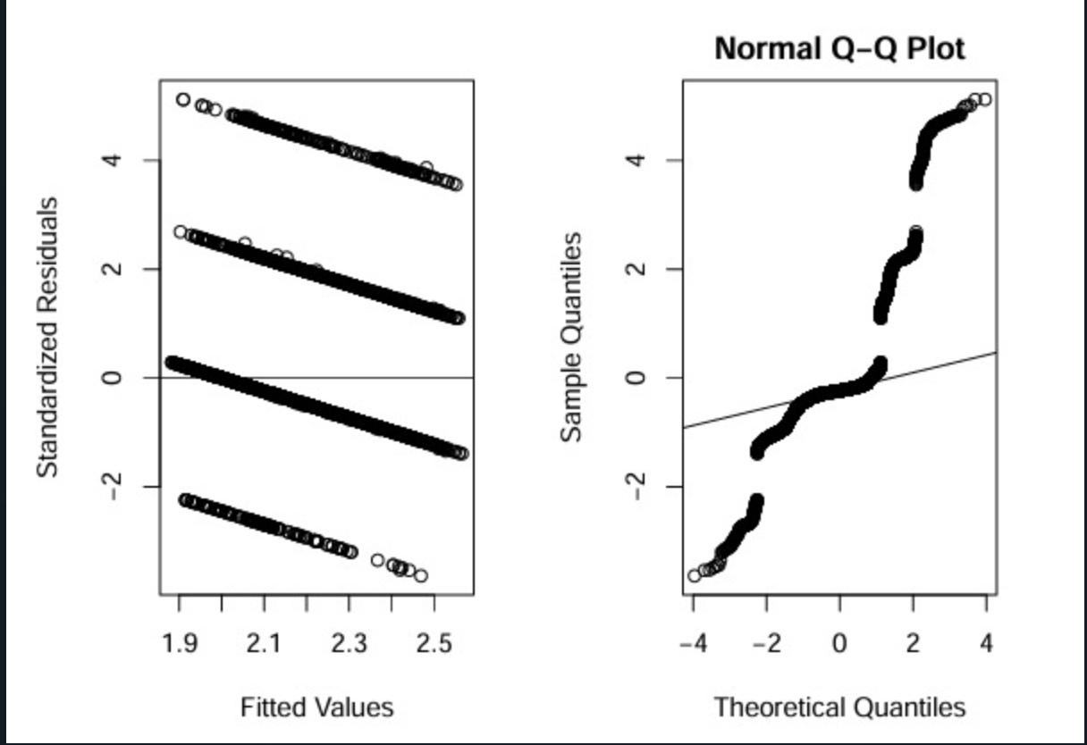
Diagnostics for reduced model
Residuals vs. Fitted Plot
Residuals form distinct horizontal bands, indicating discrete response levels (Severity = 1 to 4)
No obvious fan shape or severe heteroscedasticity
Pattern reflects the ordinal nature of the response variable rather than violation of assumptions
Q-Q Plot
Deviations from the diagonal line at both ends
Suggests non-normality in residuals
Caused by the discrete structure of the response, not by poor model fit

Slide 10
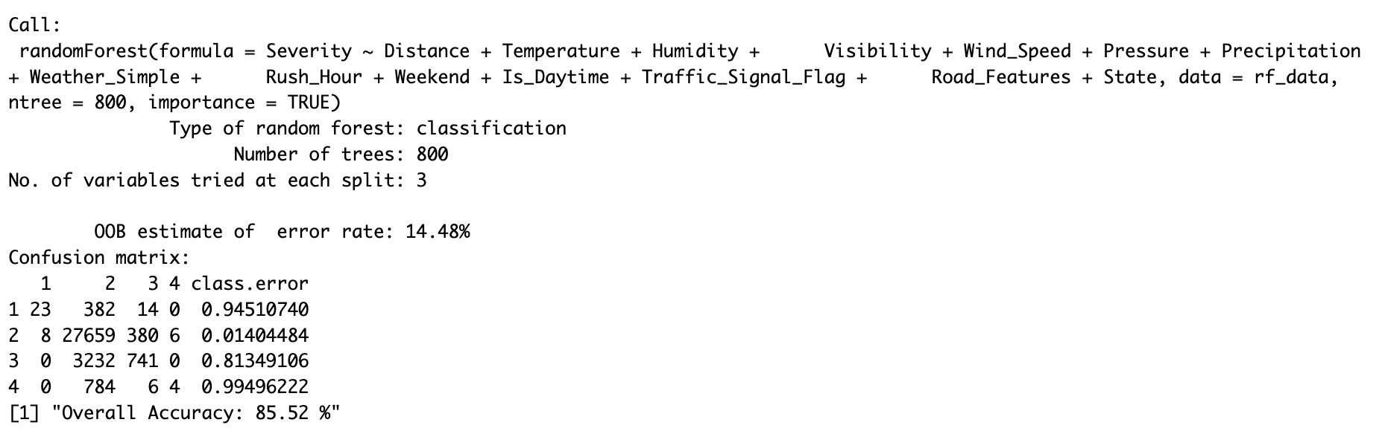
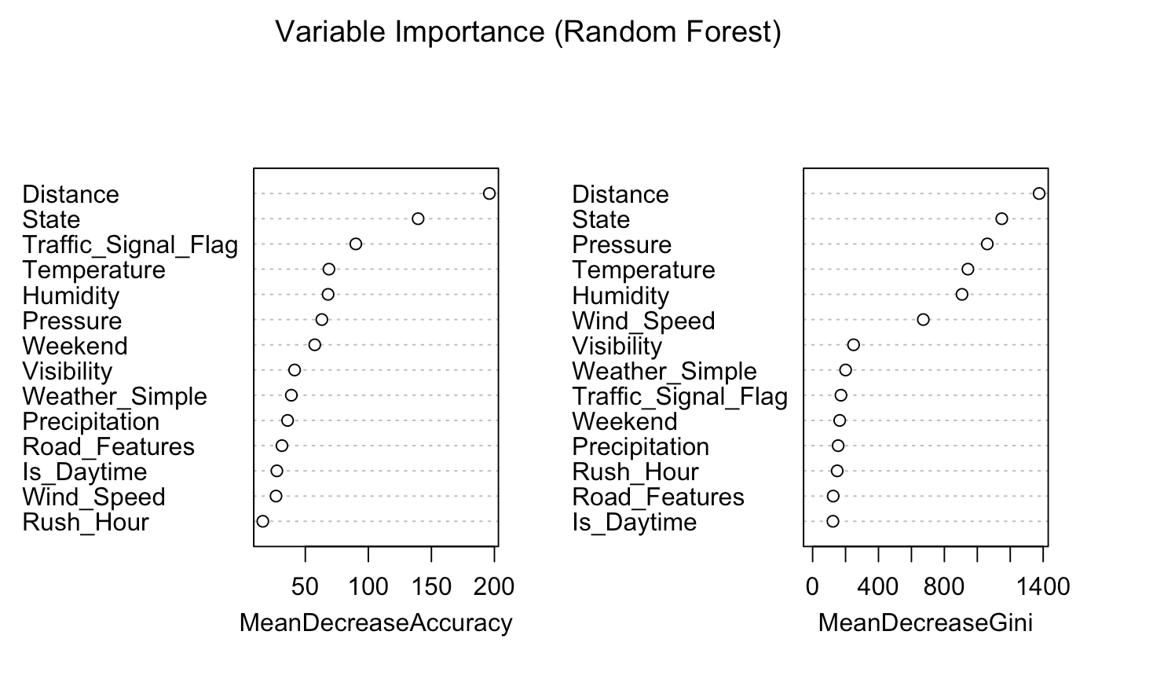
Random Forest model & Variable importance from Random Forest
Top predictors: Distance, State, Traffic Signal, Pressure
Distance is the most important feature across both metrics
State also highly influential — reflects geographic variation in severity
Traffic Signal Flag has a clear role: accidents with signals tend to be less severe
Weather and visibility play a moderate role
Peak Hour and Road Features are less important in the model
"Overall Accuracy: 85.52 %"
Notes:
maps

Slide 11
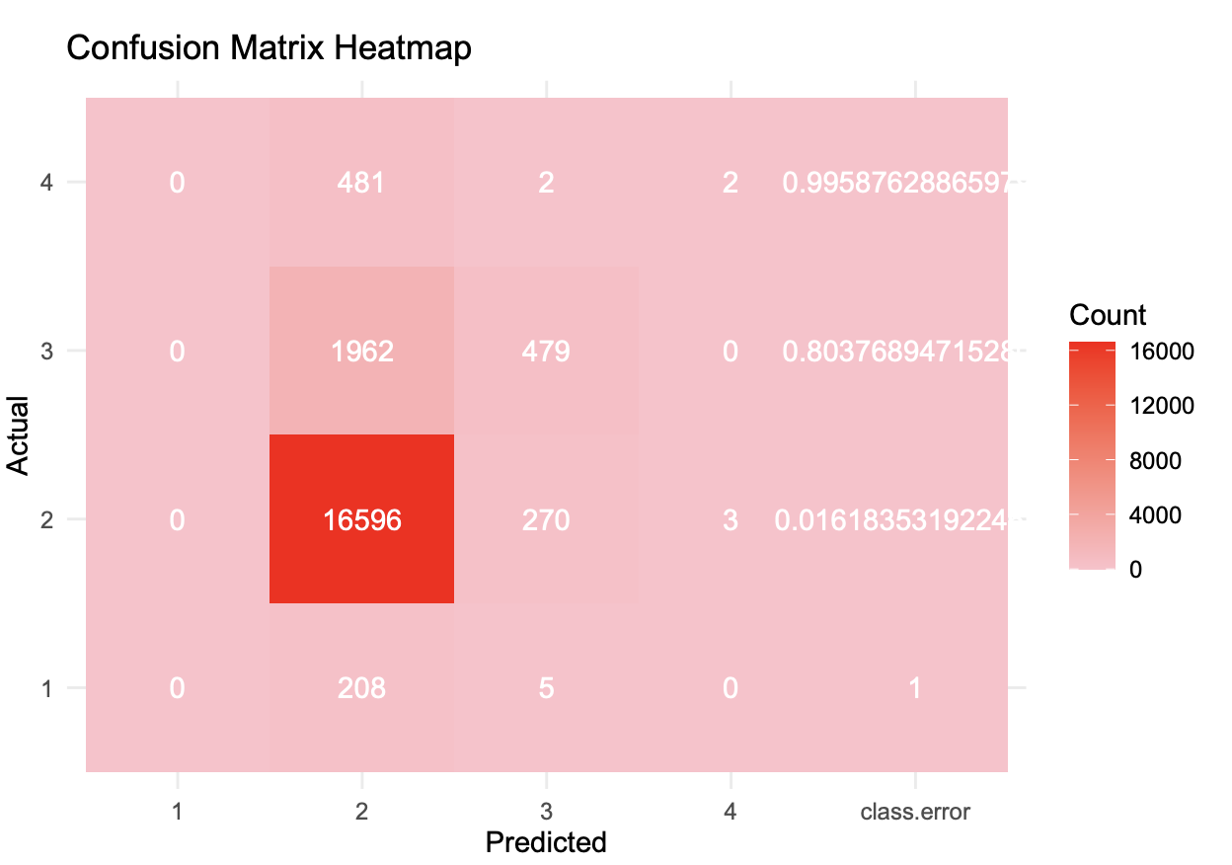
Confusion matrix heatmap (Random Forest)
The confusion matrix shows that the Random Forest model is highly accurate for the majority class (Severity = 2), but performs poorly on rare classes like Severity = 1 and 4.
This imbalance skews predictions and suggests the need for class rebalancing (e.g., SMOTE, downsampling, or weighting) to improve generalization to all severity levels.

Slide 12
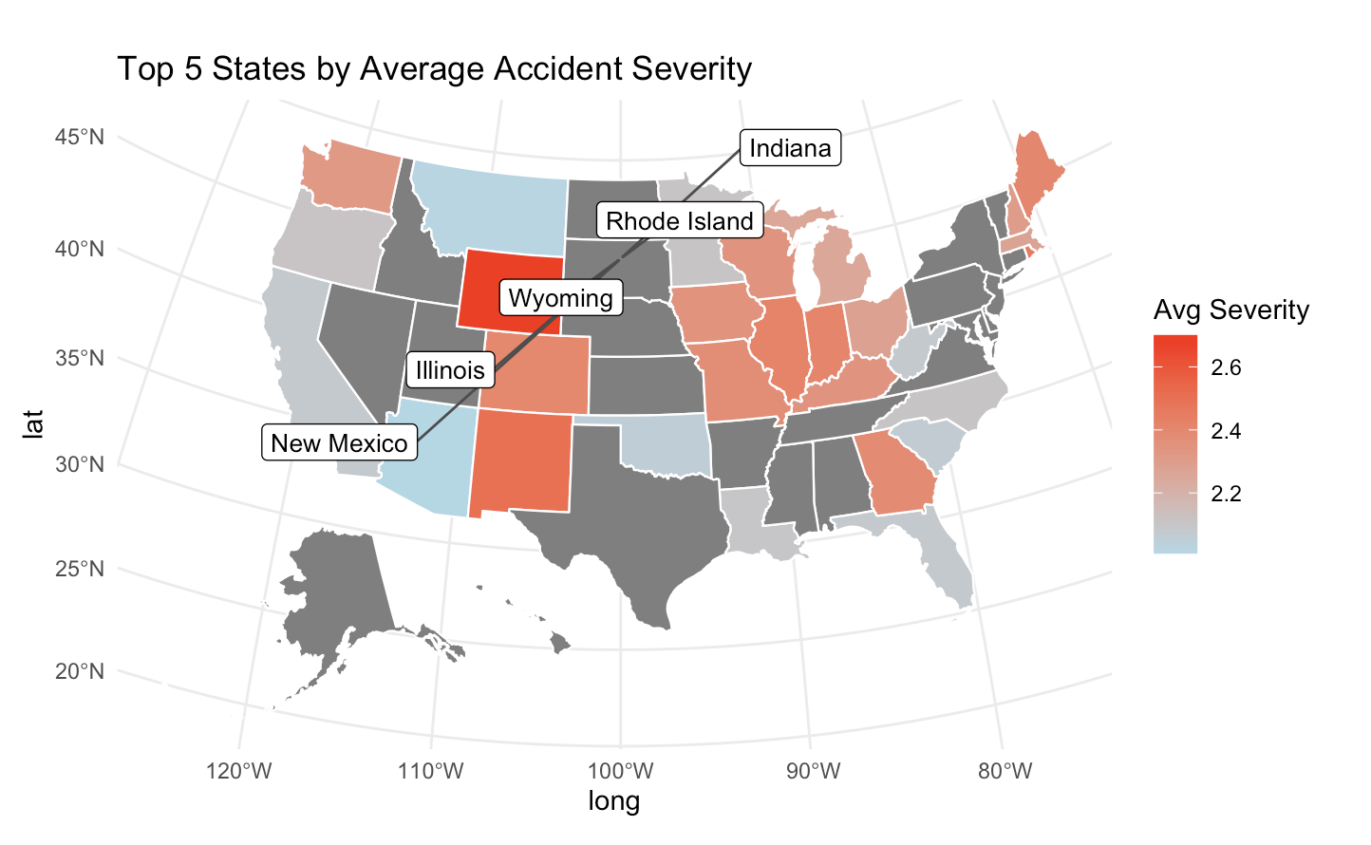
Highlighted states: Wyoming, Illinois, New Mexico, Rhode Island, Indiana
These states have the highest average severity across all crashes in the dataset
Severity ranges from ~2.4 to 2.65, with red indicating more severe crashes
Patterns suggest possible regional effects beyond weather and road conditions
Could reflect differences in driving behavior, road design, enforcement, or reporting practices

Slide 13

Conclusion:
Linear models helped us interpret relationships, while random forest gave us better accuracy.
For future work, we’d like to improve prediction for rare severity levels and include more time-based seasonal features.

Slide 14


